Slide 1
Customer Personality and Spending
SC1015 Data Science Project
Hazim / U2121788C
Jordan / U2122011E
Sufyan / U2122751J
Notes:
Hi, Im Hazim, and I am accompanied by Jordan and Sufyan. Today, we will be presenting about our Data Science Project in Customer Personality and Spending

Slide 2
Contents
Problem Statement & Goals
Exploratory Data Analysis
Random Forest Classification
Clustering
Insights
Conclusion
Notes:
These are our topics we are going to cover today

Slide 3
Customer Data
2,500,000,000,000,000,000bytes!
Personal Data
Engagement Data
Behavioural Data
Attitudinal Data
Notes:
Did you know that more than 2.5 quintillion bytes of data was generated everyday in 2020, and that number is set to increase tenfold within the next decade?
And a subset of that is customer data that companies have collected over many decades, including
personal data,
engagement data
behavioural data
attitudinal data
(How and Why Businesses Collect Your Personal Data - businessnewsdaily.com)

Slide 4
Fast Operation
Reliable Performance
Customer Insight
Notes:
As companies begin to realise the value of the data they hold, they need fast and reliable ways to break down its massive inflow into customer insights.
For some organisations customer insights is only actionable within a short period of time, and also no one wants to place their bets on unreliable data, so we need a model that can do both to ensure timely and reliable insights
https://www.pond5.com/stock-footage/item/467807-timelapse-clouds-reflected-corporate-office-building?ref=silverstepper

Slide 5
Problem Statement
Probability of customer accepting Current Promotion
Using collected customer data
2 types of Data Modelling
Random Forest Classification
Clustering
Project Goal
Notes:
Currently, our problem statement is to find the key variables that have the most significance in determining whether a customer accepts a company’s current round of promotions, which is the variable called 'Response', based on the customer data collected in the dataset.
Additionally, our project also aims to highlight the strengths and weaknesses of 2 different types of data modelling using the same dataset, and to compare the differences in the insights we obtain.
Next, lets cover the dataset and its eda

Slide 6

Notes:
We had obtained the dataset from Kaggle.com titled Customer Personality Analysis because it was realistic in terms of containing many types of customer attributes that a real organisation can collect about their customers either during registration or when the customer has been with the company for many years. The dataset also included opportunities for data cleaning to demonstrate our different methods.

Slide 7
Exploratory Data Analysis
01
Notes:
Hi I am Jordan, I will be bringing you through the Exploratory Data Analysis

Slide 8
01
02
03
Personal Data
Engagement Data
Behavioral Data
Customer Attributes
04
Attitudinal Data
Birth Year
Education
Marital Status
Income
No. of children at home
Account Age
Days since Purchase
Web Purchases
Catalog Purchases
Store Purchases
Website Visits
Monthly Spending on:
Wine
Fruits
Meat
Fish
Sweets
Gold
Discount Usage
No. of Complaints
Past Sales Campaigns
Current Sales Campaign
Notes:
Our dataset contained all 4 elements of customer data typically collected by companies, and they can all be categorised accordingly
This includes personal data
We also had customer Engagement data,
Behavioural data
Lastly, the Attitudinal data

Slide 9
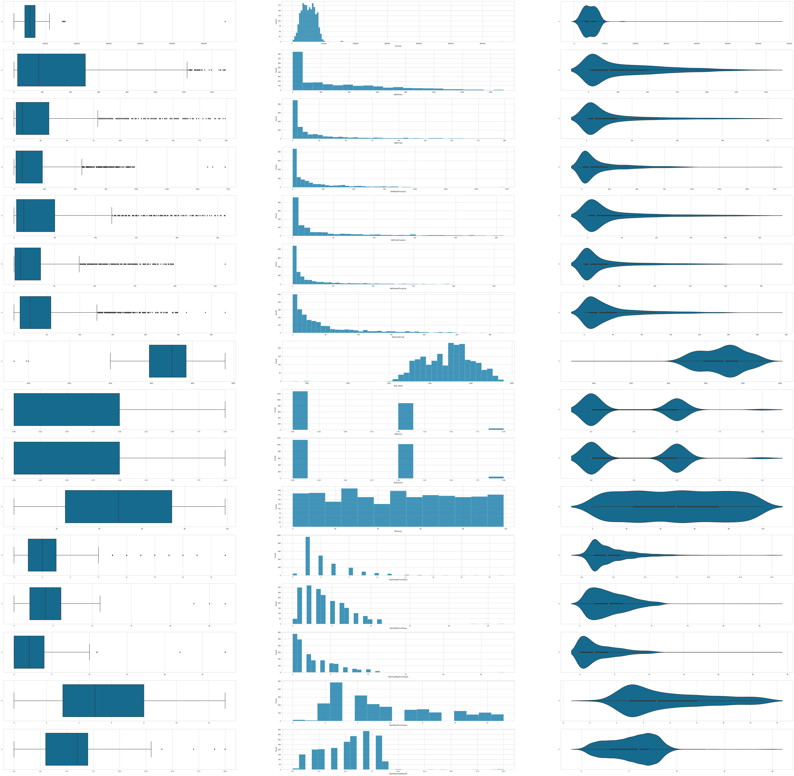
Numeric Variables
Median Income: $51381.50
Median Expenditure for:
Wine: $174.50
Fruits: $8.00
Meat: $68.00
Fish: $12.00
Sweets: $8.00
Gold: $24.50
Birth Dates
Notes:
Taking a look at our numerical predictors first, we find that the median income for our customers were around 50,000 dollars
Next, we have a range of variables for the types of expenditures of our customers, ranging from daily necessities to gold.
We get to see some irregularities with our data here, such as customers born before the 1900s that are candidates for data cleaning

Slide 10
Numeric Variables
No. of Children
Kids < 12
13 < Teenagers < 19
Customer Last Visit
Special Offer Usage
Avenue of Sale
Web
Catalogue
In-Store
Website Visits
Notes:
For the number of children in a household, it is split between children under the age of 12 and teenagers between the ages 13 to 19 years old
For recency in which a customer visited the store, We can see that the median is 49 days, and the longest account without any purchase activity is at 99 days.
Discount usage is important for company to gauge if customers use them.
The avenue of sale informs companies on where their customers mainly interact with them
Lastly, we also have the quantifiable value of website visits.

Slide 11
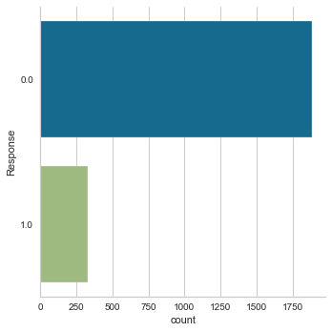
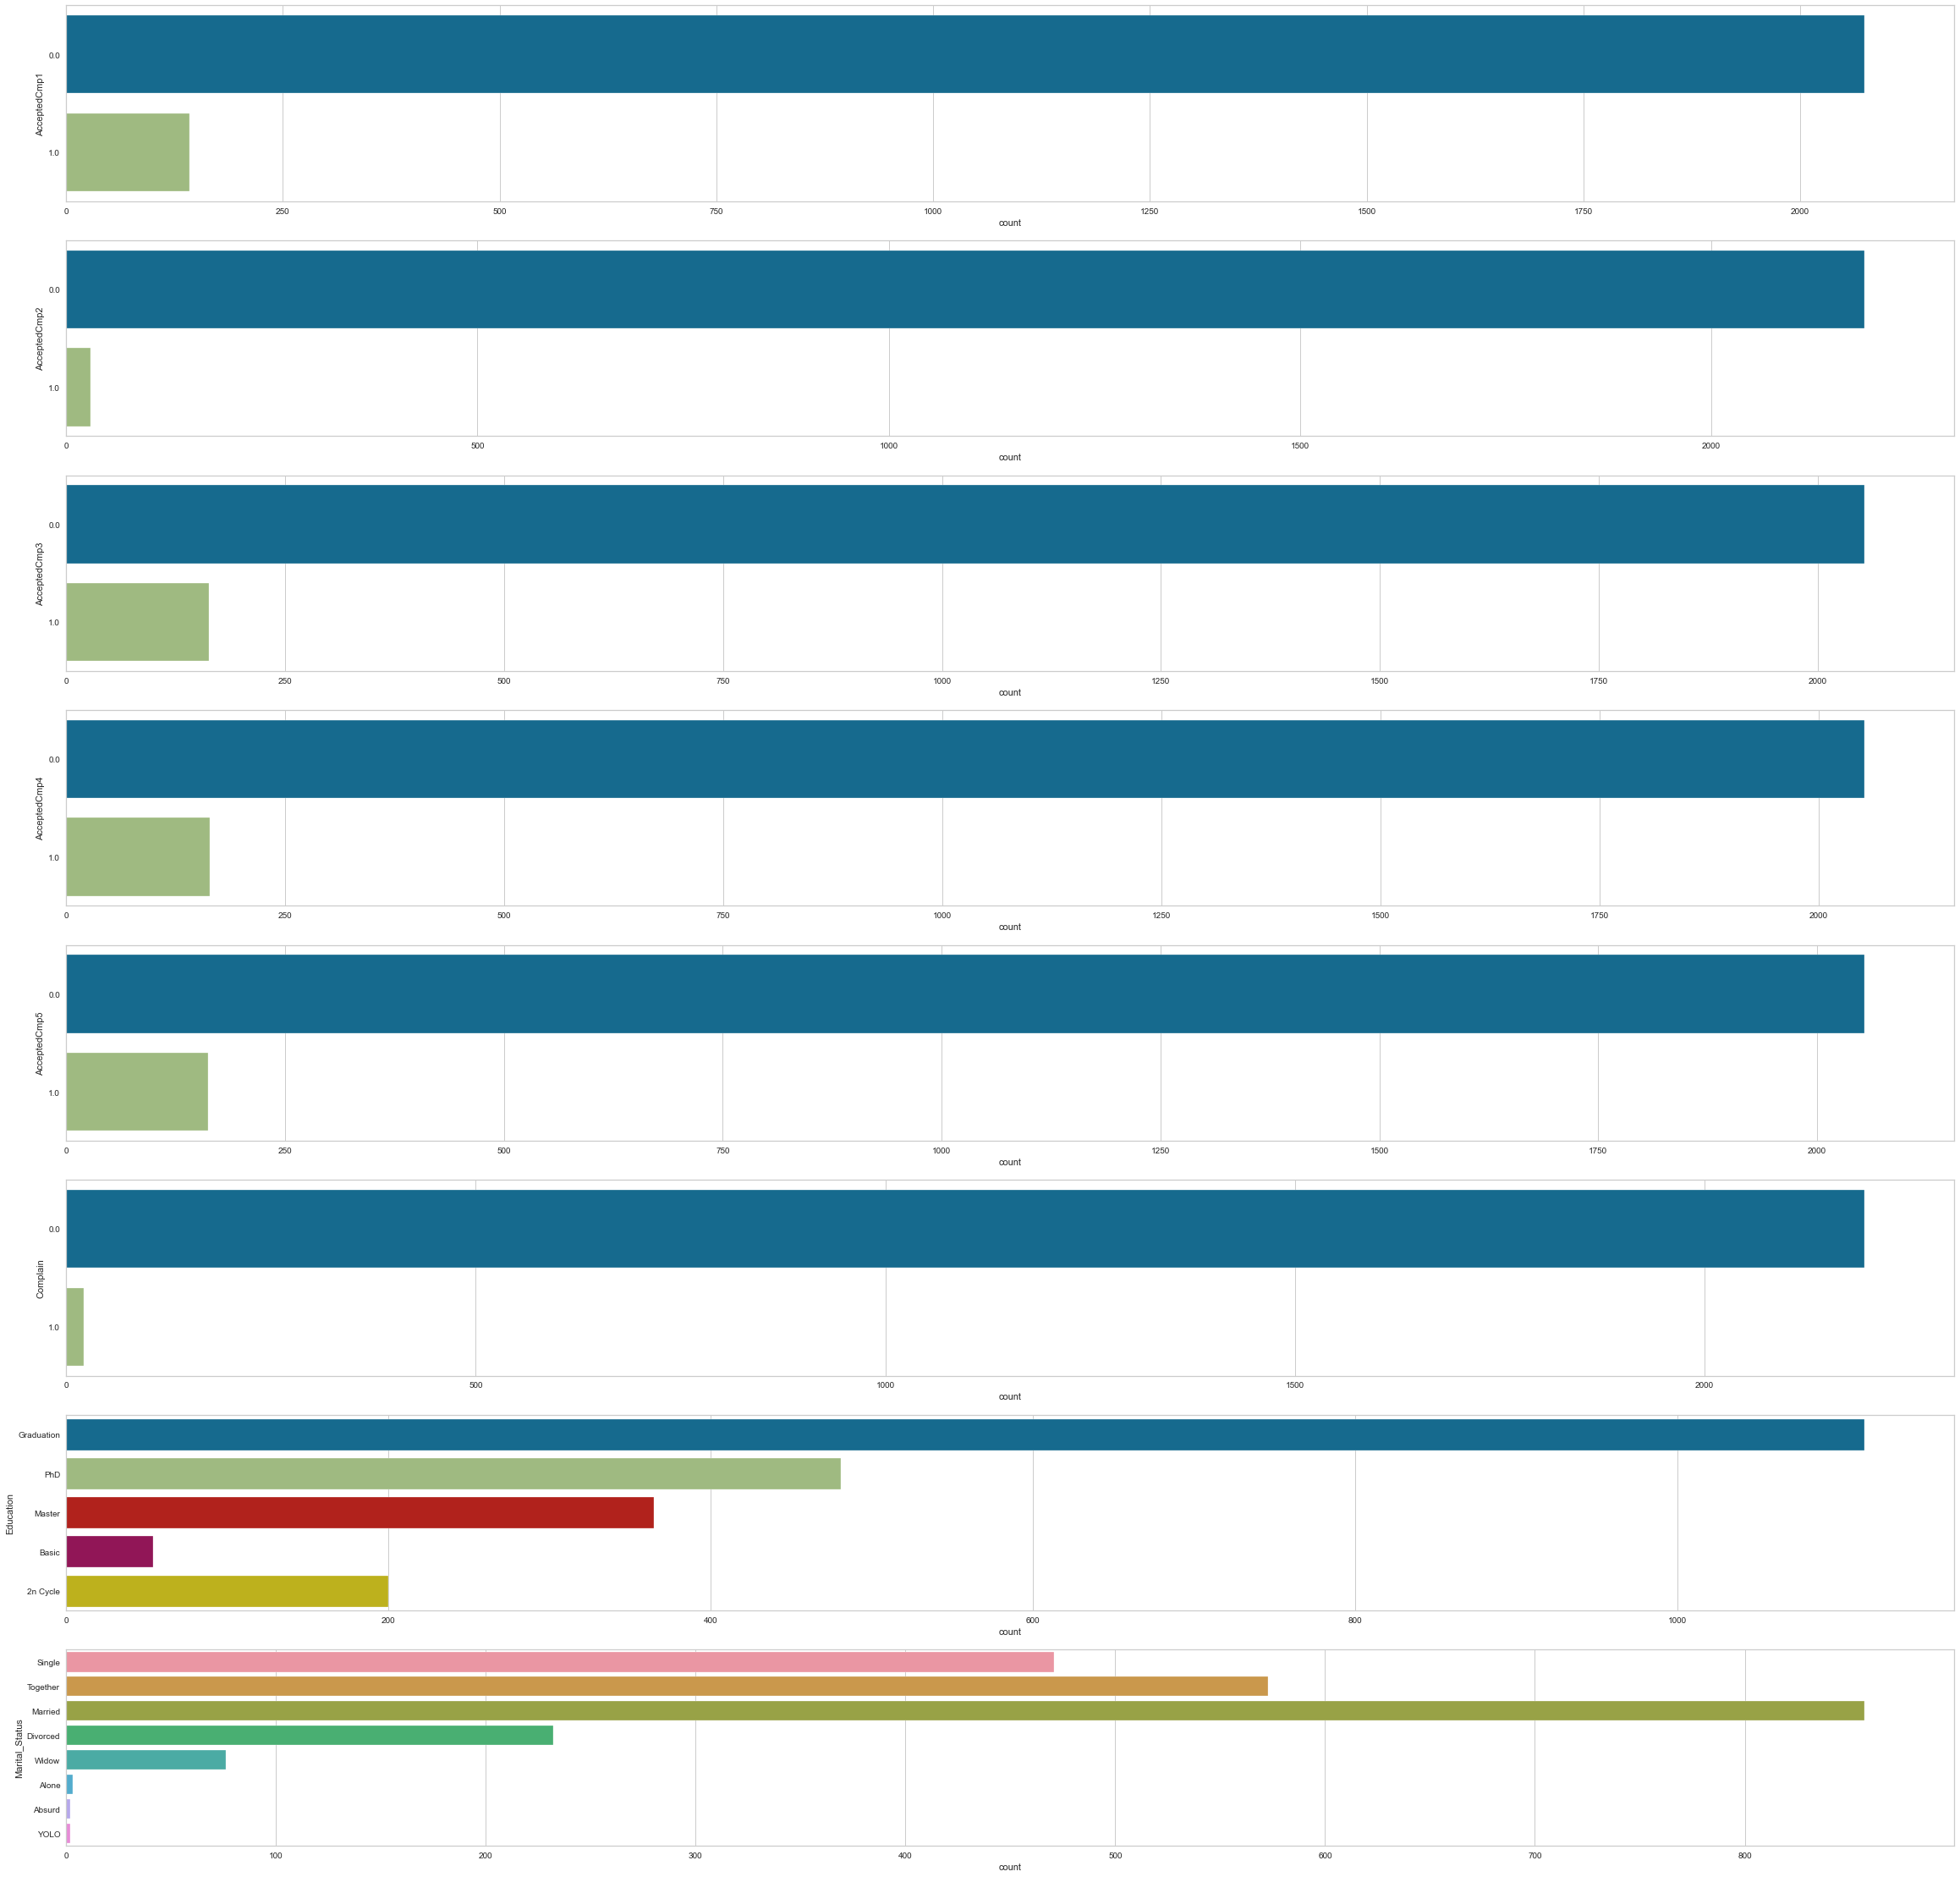
Categorical Variables
Response Variable
Current Offer Acceptance
Previous Offer Acceptance
No. of Complaints
Education Level
Marital Status
Notes:
Looking at our categorical predictors, we first start off with the current offer acceptance..
We can see that a large percentage of customers, around 90% who did not participate in the past campaigns did not accept the current campaign.
A very small percentage of people, less than 1% who complained accepted the current response subsequently.
There are many customers who are graduates from university.
Majority of customers are Couples.

Slide 12
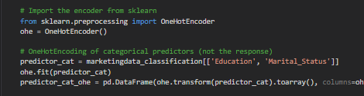
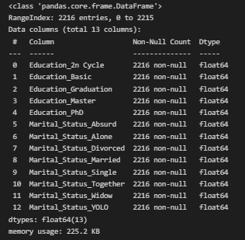
One-Hot Encoding
Input:
Output:
Notes:
We will have to do one-hot encoding for categorical variables.
Can see that categorical variables are encoded.

Slide 13
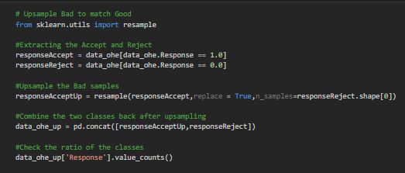
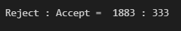
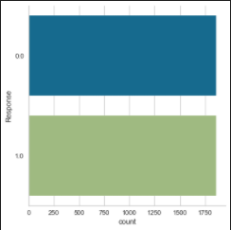
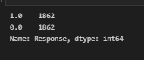
Up-Sampling
Input:
Output:
Notes:
We need to resample the to balance the class of the response variable `Response` in the training data so that there will not be a huge imbalance.
We can see that the classes are balanced after the up-sampling of the number of people who accepted the response.

Slide 14
Random Forest Classification
02
Notes:
Now I will take you through the first machine learning model that we used, classification using random forest.

Slide 15
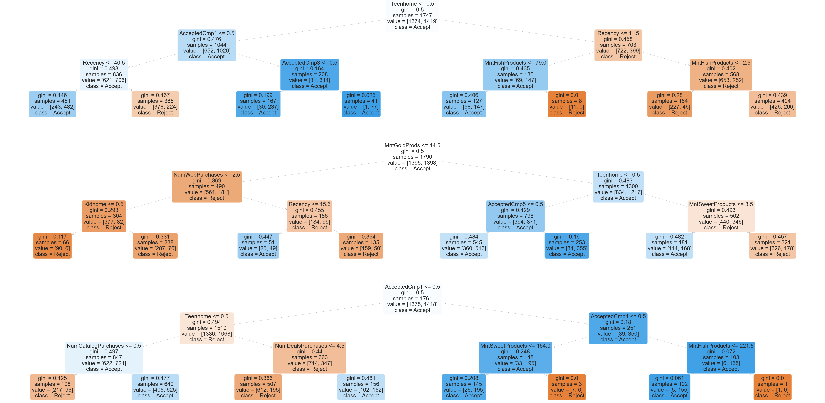
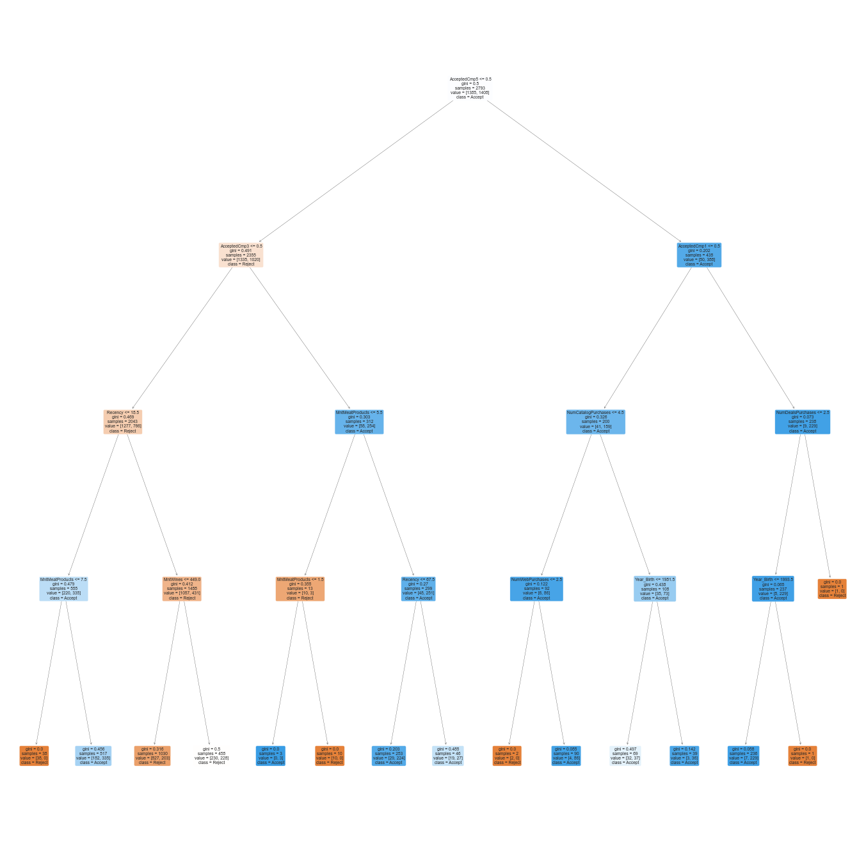
Random Forest vs. Single Tree
Random Forest
Classification And Regression Trees (CART)
Uses random subset of predictors each split
Uses bootstrap sample
Each tree specialised
Multiple trees → Averaged output
Single Tree
Classification And Regression Trees (CART)
Tries ALL predictors each split
Uses full training set
One tree → One output
Notes:
When we generate the random trees, we had generated 100 trees in the range, and we have a handful of these trees printed out.
Both a random forest and a single tree uses the same algorithm for building a decision tree based on Gini's impurity index to decide every split.
A single tree tries all predictors at each split, whereas trees in RF only tries a random subset of the predictors at each split.
Additionally, while Single Trees use the full training dataset at each split, a Random Forest only uses a bootstrap sample of the original training data.
When the output and agreement of a group of expert trees is obtained, the result would be more accurate than relying on only a single tree where one decision is obtained

Slide 16
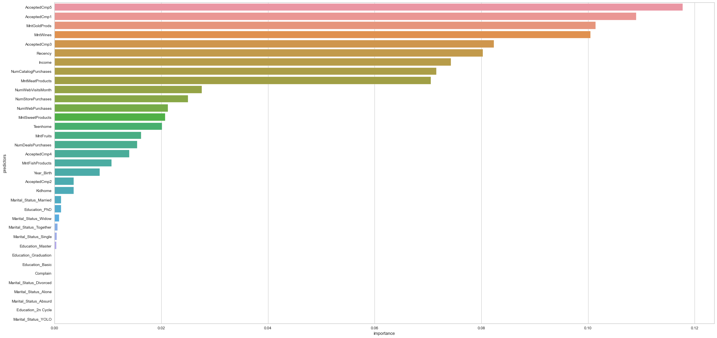
s
1st Campaign: 55.63%
2nd Campaign: 66.67%
3rd Campaign: 47.24%
4th Campaign: 37.80%
5th Campaign: 56.17%
1. Accepted Campaign 5
2. Accepted Campaign 1
3. Gold Spend
4. Wine Spend
s
1st Campaign: 55.63%
2nd Campaign: 66.67%
3rd Campaign: 47.24%
4th Campaign: 37.80%
5th Campaign: 56.17%
Notes:
Obtaining the most important features from our random forest, we can see they are accepting the 5th campaign, their decision in the first campaign, their gold spending and amount spent on wine.

Slide 17
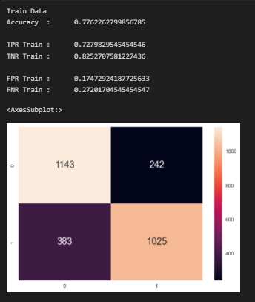
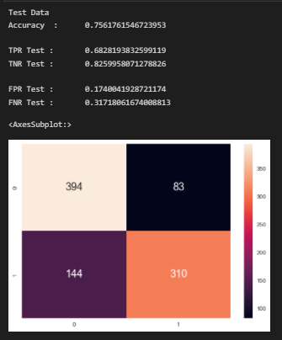
Accuracy of Model
Train:
Test:
Notes:
For the trained data set, the accuracy of the model is 78%.
For the test data set, the accuracy of the model is 76%.
While the accuracy of the model decreased by 2% the drop is not significant, however there is still much improvements to be made to the classification model in general.
We can look to tune the hyperparameters of the random forest and perform Cross-Validation on our analysis.

Slide 18
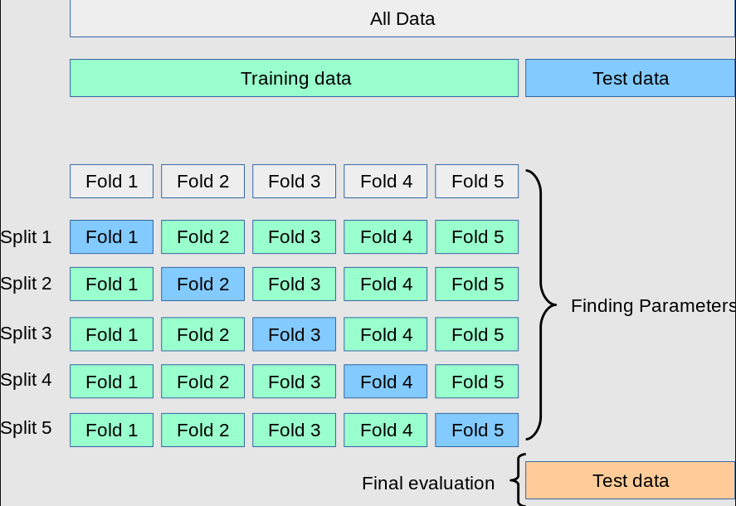
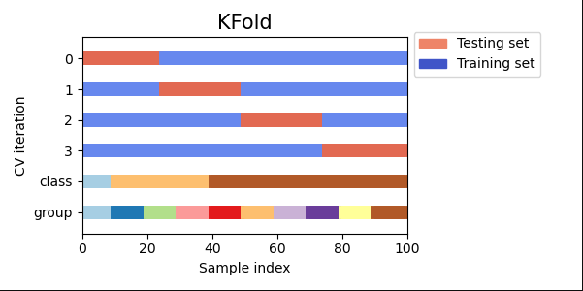
Cross-Validation (CV)
Notes:
For CV, each observation in the data sample is assigned to an individual group and stays in that group for the duration of the procedure.
This means that each sample is given the opportunity to be used in the hold out set 1 time and used to train the model k-1 times.
We will try out GridSearchCV

Slide 19
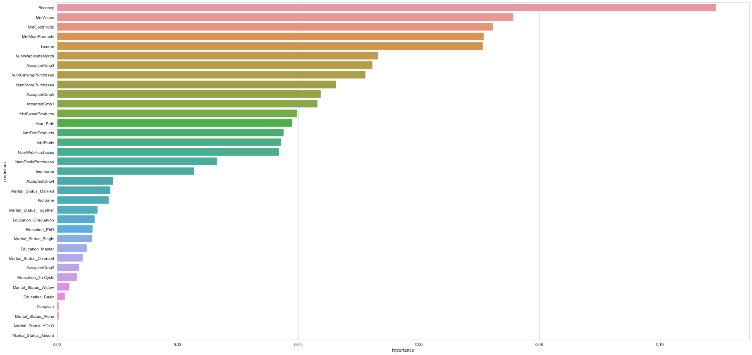
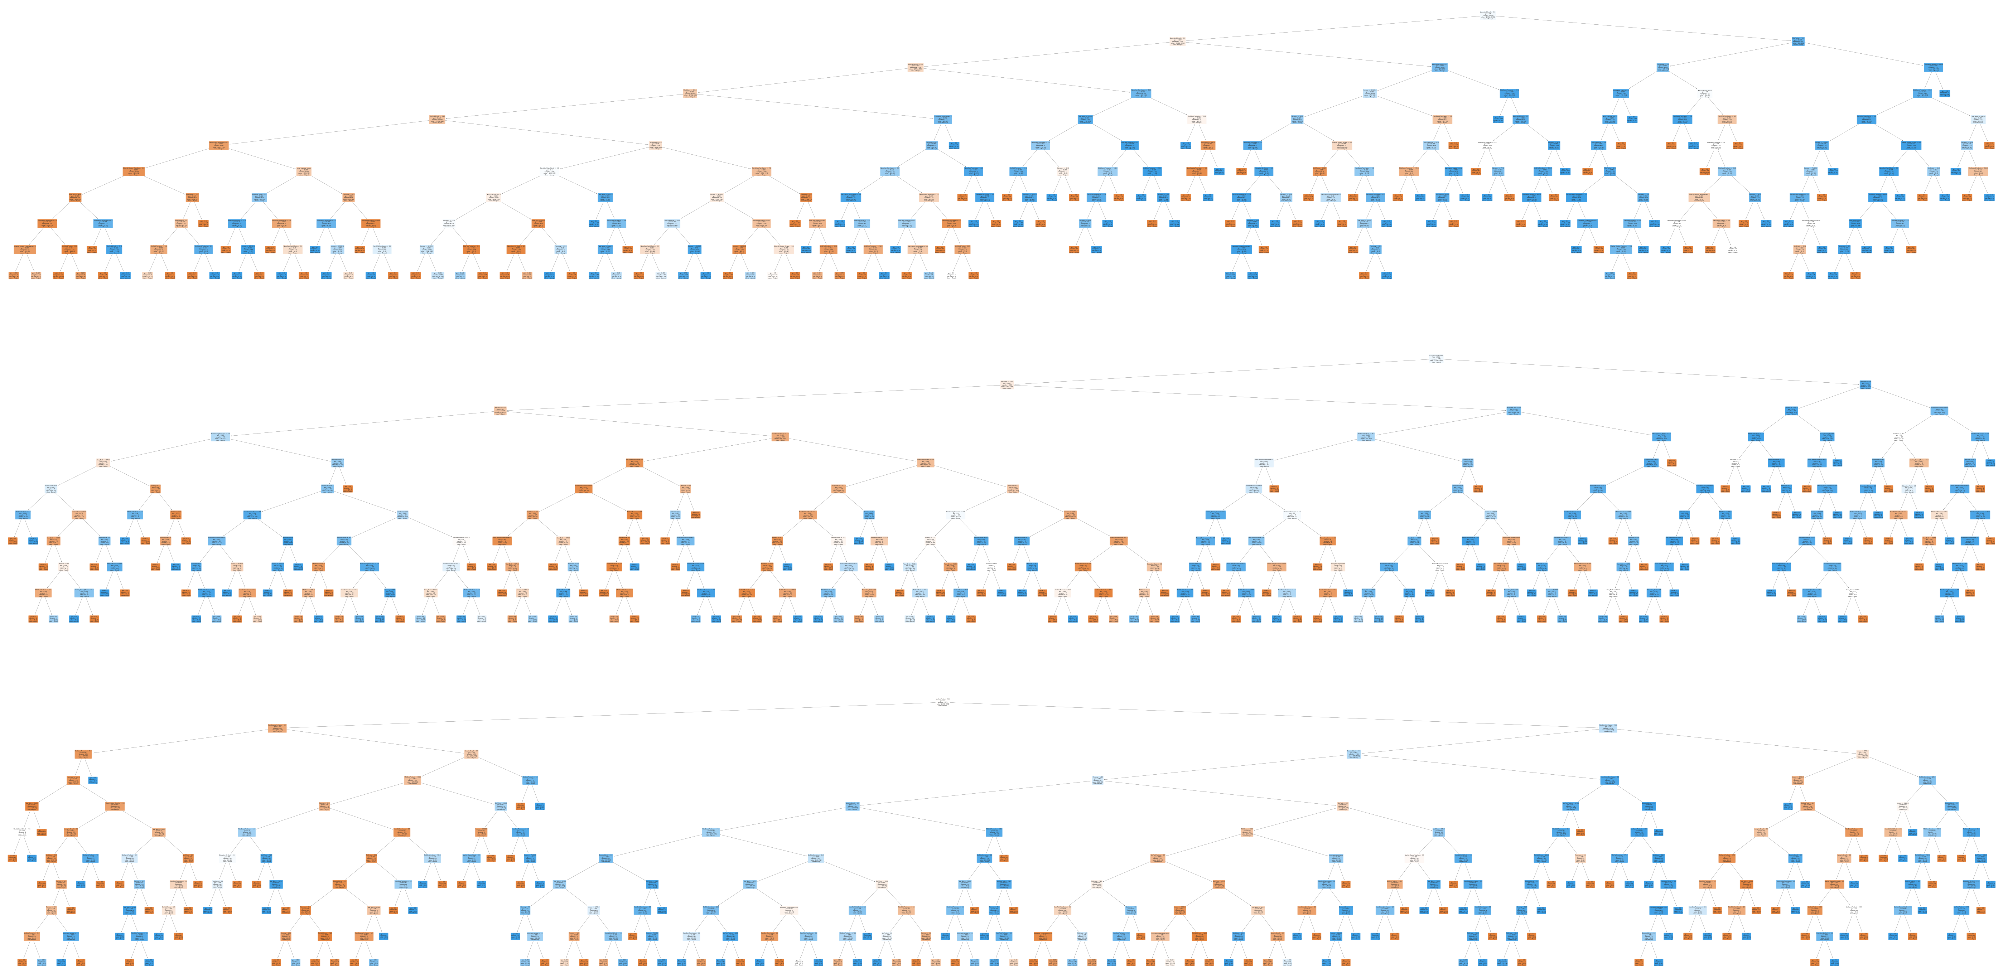
GridSearchCV
RandomForestClassifier(max_depth=10, n_estimators=800)
0.9878858228647847
1. Recency
2. Wine Spend
3. Gold Spend
4. Meat Spend
5. Monthly Income
Notes:
GridSearchCV searches through predefined hyperparameters and fit our estimator (model) on your training set and evaluates the best hyper parameters for our test data. In our case, a Random Forest of max depth 10 with 800 trees.
Obtaining the most important features from our random forest, they are the customer’s recency in which the visited the store, the amount they spent on wine, gold products, meat products and finally their income level.

Slide 20
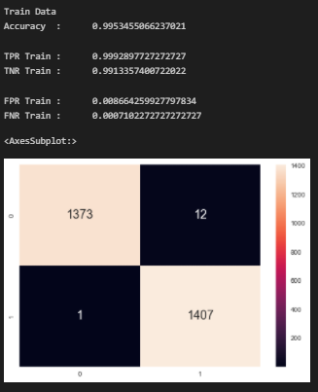
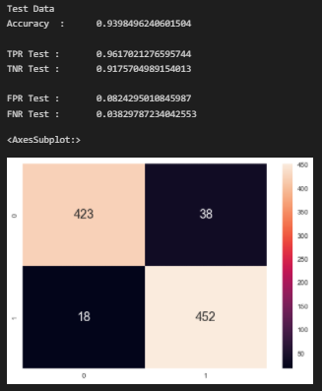
Accuracy of Model
Train:
Test:
Notes:
For the trained data set, the accuracy of the model is 99%.
For the test data set, the accuracy of the model is 93%.
This tells us that the model is very accurate.

Slide 21
Clustering
03
Notes:
Im Sufyan and I'll be going through the application of clustering on our dataset.

Slide 22
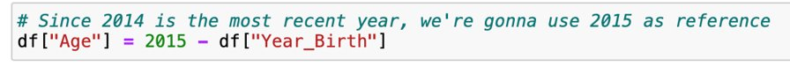
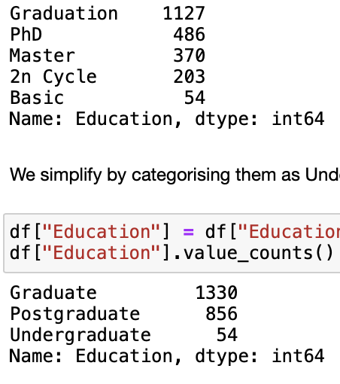
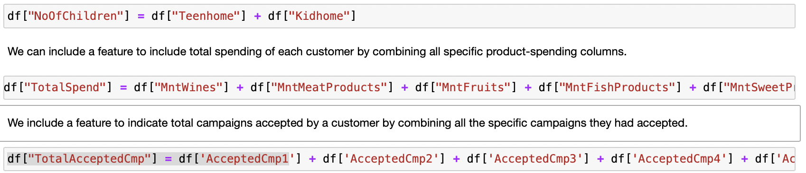
Similar Trend to:
Total Spending
Accepted Campaigns
Same as Income Factor
Higher incomes → More Campaigns
Generalising Features
Birth Year → Age
Educational Level
PhD/Masters → Postgraduates
Graduation/2n Cycle → Graduates
Basic → Undergraduates
Teens + Kids → No. of Children
All Product Spend → Total Spend
Prev + Curr Campaigns →
Total Accepted Campaign
Similar Trend to:
Total Spending
Accepted Campaigns
Same as Income Factor
Higher incomes → More Campaigns
Notes:
First, we generalise some features.
We create a new feature to indicate the age of customers by subtracting their birth year from reference year, 2015.
For the customers' education level, we reclassified PHD & Masters as postgraduates, 2n cycle & graduation as graduates & basic as undergrads.
We also create a new feature for the customers' number of children by combining their kids and teens together.
We then include a new feature, customers' total spending, by combining amount spent on the individual products.
Lastly, we implement a new feature, customers' total accepted campaigns, by combining previous and current campaigns

Slide 23
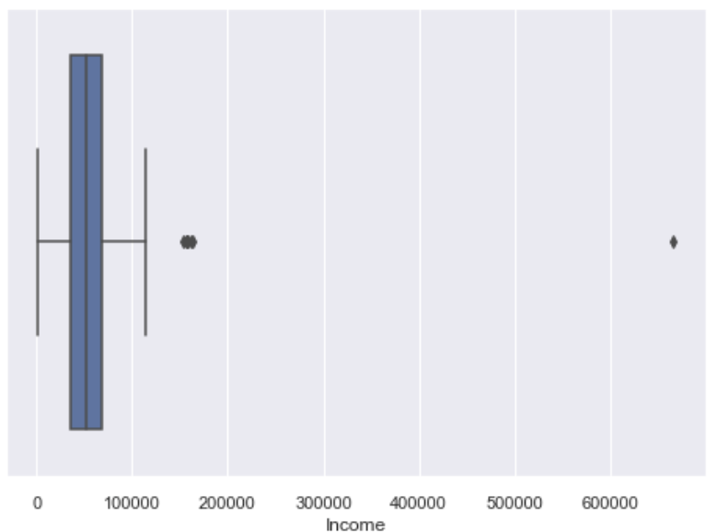
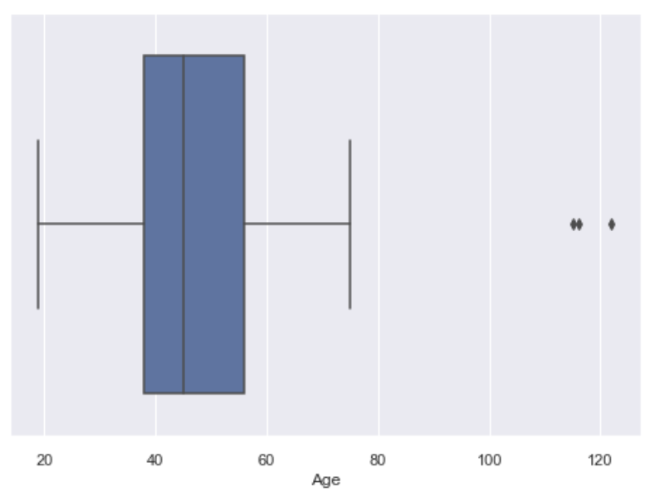
Removing Obvious Outliers
Age
Customers > 100
Income
Income > $600,000
Notes:
Next, we remove outliers because outliers can affect the clustering model as they can show up as a separate cluster and also cause other clusters to merge.
We find that for age, there are 3 outlier customers who are above 100 years old.
Likewise for customers' income, there's an outlier customer with an income over $600000.
Since the outliers are a few, we removed them without consequences

Slide 24
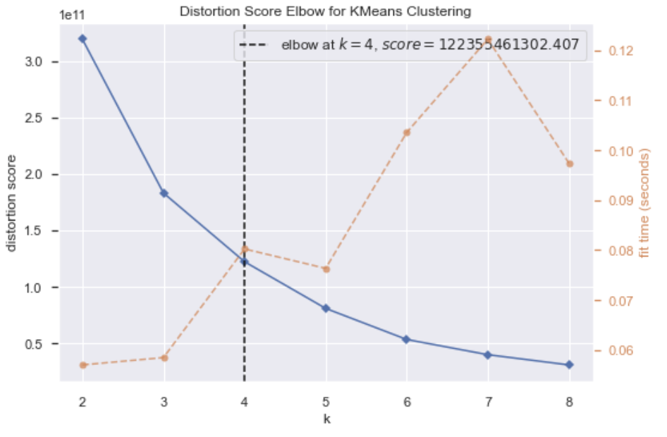
K-Elbow Visualiser
Optimal No. of Clusters
Notes:
Next, we use K-elbow vizualiser, which implements the elbow method and a simple ML algorithm to find the optimal number of clusters which in this case is 4.

Slide 25
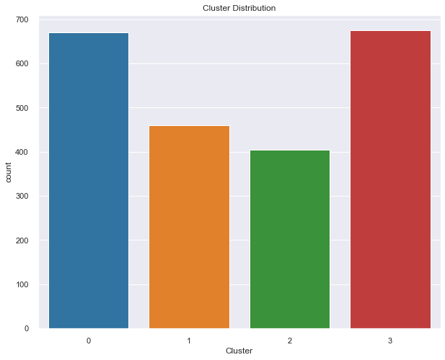
Using K-Means++
Notes:
Then we use kmeans++ to group the data into 4 clusters as seen. We will interpret the clusters.

Slide 26
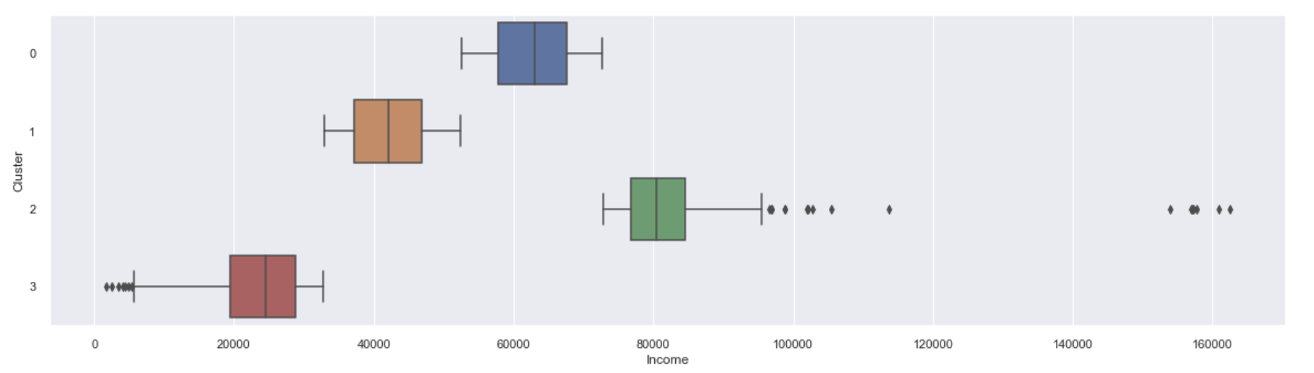
Observations
Cluster 2
Cluster 0
Cluster 1
Cluster 3
Distinct Differences in Income
Represented by Income Pyramid
Notes:
By generating boxplots for the individual features against the clusters, we find that the clusters are most apparent in terms of differences of income.

Slide 27
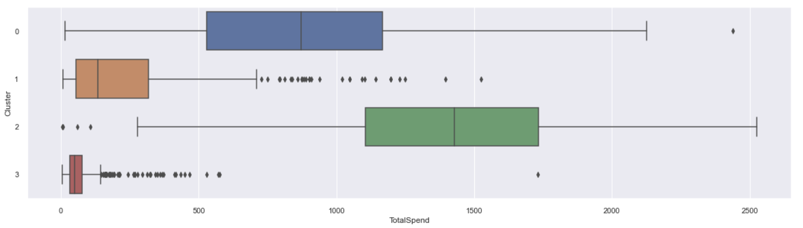
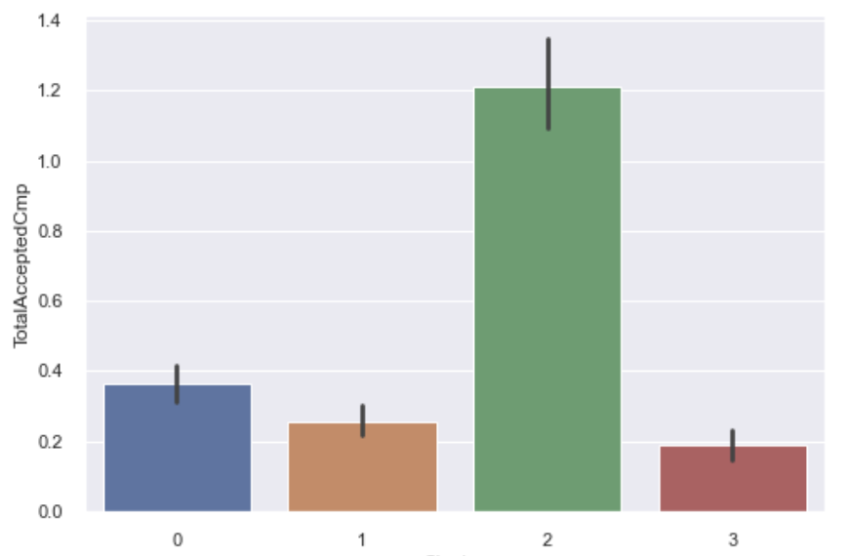
Observations
Similar Trend to:
Total Spending
Accepted Campaigns
Same as Income Factor
Higher incomes → More Campaigns
Cluster 2
Cluster 0
Cluster 1
Cluster 3
Notes:
For total spending and total accepted campaigns, we see a similar trend when comparing the income pyramid. Both features have the same ranking as the income factor
Therefore we can conclude that customers with higher incomes spend more and accepted more campaigns

Slide 28
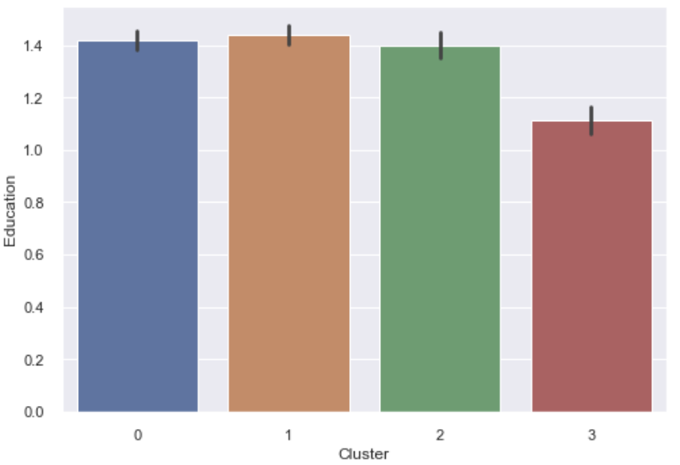
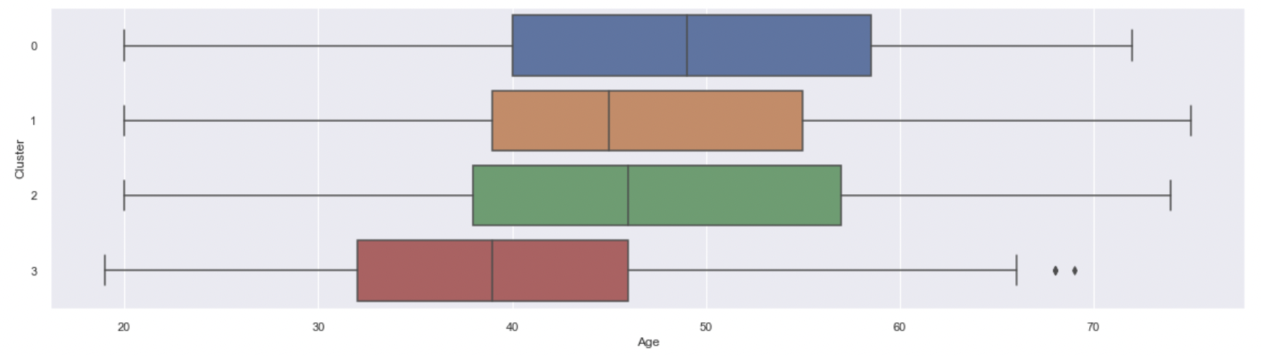
Observations
Cluster 2
Cluster 0
Cluster 1
Cluster 3
Cluster 3 (on avg.)
Lowest Income
Lowest Education
Lowest Age
Notes:
Cluster 3, other than being lowest in income, and therefore, in total spending and total campaigns accepted, is also significantly lower than the other clusters in age & education

Slide 29
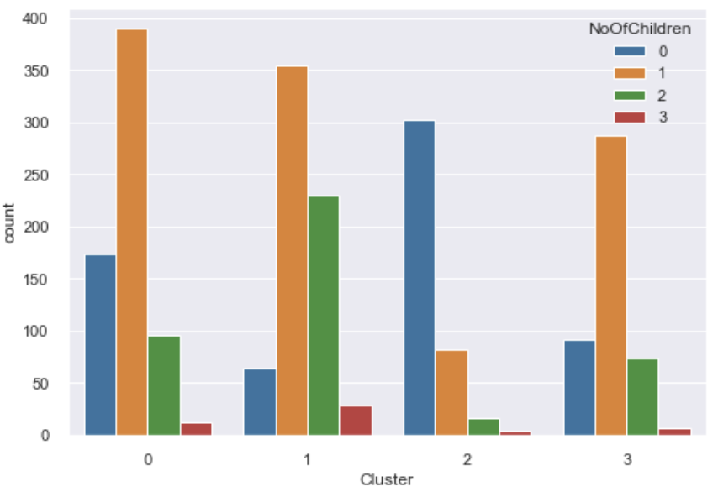
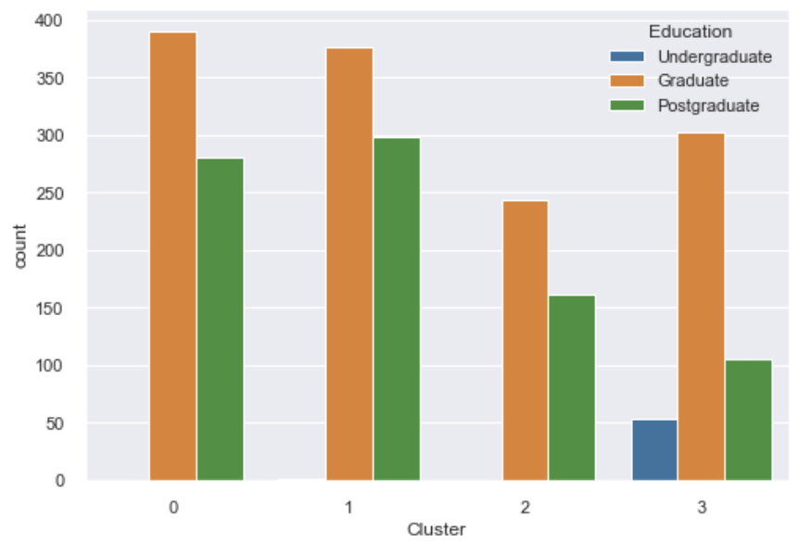
Observations
Cluster 3 (on avg.)
Lowest Income
Lowest Education
Lowest Age
Cluster 2 → Mostly No Kids
Clusters 0,1,3 → Mostly 1 Kid
Notes:
It turns out,
In terms of education levels, all the customers who are undergraduates are in Cluster 3
Cluster 3 also has higher ratio of graduates to postgraduates compared with other clusters.
This shows that 3 is mostly young customers who are still studying or just recently graduated.
When exploring cluster 2, it is interesting to note that customers in 2 mostly have no children while other clusters mostly have 1 child.

Slide 30
Insights
04
Notes:
Ill now be covering the insights gained from both models

Slide 31
Classification vs Clustering
Classification | Clustering
Uses labelled data as input | Uses unlabeled data as input
The output is known | The output is unknown
Uses supervised machine learning | Uses unsupervised machine learning
A training data set is provided and used to produce classifications | A training data set is not provided and used to produce clusters
Examples of Algorithms: Random Forest, Decision-Trees, K-Nearest Neighbors | Examples of Algorithms: K-means, DBSCAN, BIRCH
Does not specify areas for improvement | Specifies areas for improvement
Boundary conditions must be specified | Boundary conditions not needed to be specified
Notes:
After running both classification and clustering, we have summed up the distinct differences between them here.
The most important characteristics among them are
needing to know the output beforehand for classification and
not needing a train-test splits for clustering.

Slide 32
Classification Insights
1. Recency
2. Wine Spend
3. Gold Spend
4. Meat Spend
5. Monthly Income
Notes:
For classification, we were able to pinpoint the characteristics of customers which determines whether they accept or reject the campaign.
In our model, frequent visitors are more likely to accept our campaign. We identified key patterns in customer purchasing behavior, to subsequently increase sales and customer satisfaction by anticipating customer behavior.
For customers who spends more on wine, gold and meat, our results recommend the company to implement membership benefits to maintain customer acceptance of our campaigns
For customers who have a lesser income and do not accept certain campaigns, we can cater to them by providing them discounts for essential goods in future campaigns

Slide 33
Clustering Insights
Cluster 2 (Highest Income)
Highest Rates of:
Income
Total Spending
Accepted Campaigns
Postgraduates & Graduates
Mostly 0 Children
Cluster 3 (Lowest Income)
Lowest Rates of:
Income
Total Spending
Accepted Campaigns
Mostly Young
Mostly Undergraduates & Graduates
Note:
No significant difference in age and education level among Cluster 0, 1 and 2
Notes:
Our KMeans clustering model grouped the customers based on their income.
We see in their behaviour that those with higher incomes also spent more and accepted more campaigns.
Cluster 2 consists of customers with the highest incomes. They are mostly graduates and postgraduates. These customers also mostly have no children when compared to other clusters
Cluster 3 consists of customers with the lowest income, lowest total spending, and accepted the least campaigns. They are mostly young and are undergrads and graduates

Slide 34
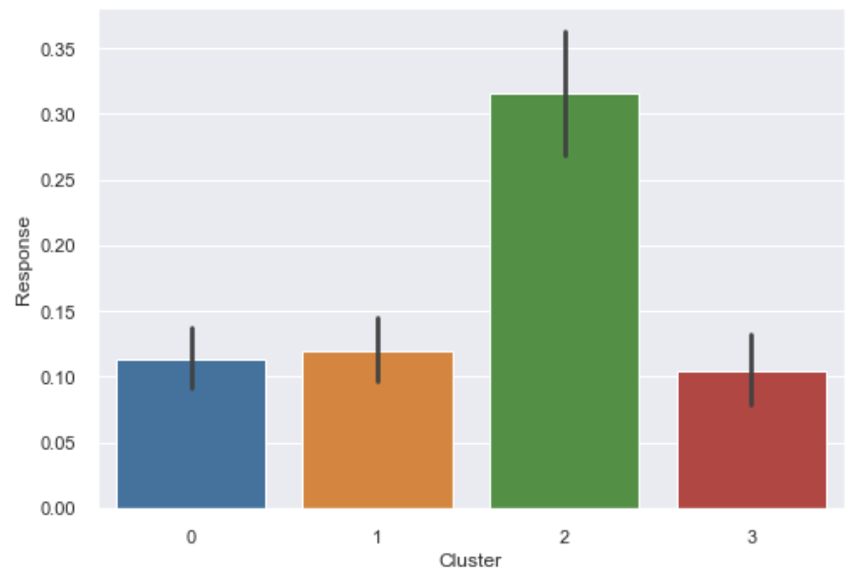
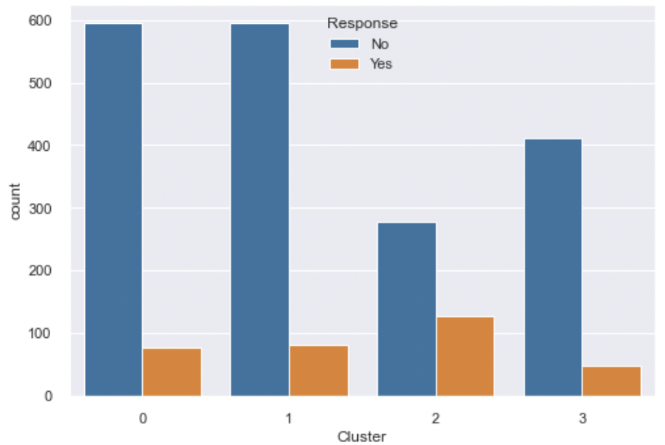
Clustering Insights
Although most people in Cluster 2 rejected the response campaign, the ratio of acceptance to rejection is much higher compared with other clusters.
Almost 1:2.
Notes:
Although most people in Cluster 2 rejected the campaign, it still had the highest rate of acceptance among the other clusters. Thus, the company should provide them with long term benefits as a member since they can be persuaded to participate in campaigns, therefore extracting more value from these customers
Conversely, cluster 3 are mostly young customers who are undergraduates or recent graduates. To attract this potential base, our company can modify its campaigns to include student deals and promotions for these young and still studying customers.
Cluster 0 and 1 have the highest spending on wines but the lowest rate of offer acceptance, so perhaps more wine stock and campaigns can be considered by the company to take advantage of these remaining clusters of customers

Slide 35
Conclusion
05
Notes:
In conclusion, classification and clustering are two useful machine learning approaches for improving business operations. Although these methods are similar, they may be used in different ways to better understand customers and improve their buying experience. By employing machine learning to analyze, profile, and target customers, companies will eventually establish a devoted customer base and enjoy a return on investment in Machine Learning.

Slide 36
THANK YOU!

Slide 37
References
3.1. Cross-validation: Evaluating estimator performance. (n.d.). Scikit-Learn. Retrieved April 23, 2022, from https://scikit-learn/stable/modules/cross_validation.html
Classification vs Clustering: When To Use Each In Your Business. (n.d.). Retrieved April 23, 2022, from https://www.dotactiv.com/blog/classification-vs-clustering
Customer Personality Analysis. (n.d.). Retrieved April 23, 2022, from https://www.kaggle.com/imakash3011/customer-personality-analysis
Customer Personality Analysis with Python. (2021, February 8). Data Science | Machine Learning | Python | C++ | Coding | Programming | JavaScript. https://thecleverprogrammer.com/2021/02/08/customer-personality-analysis-with-python/
Effect of outliers on K-Means algorithm using Python | by S Joel Franklin | Analytics Vidhya | Medium. (n.d.). Retrieved April 23, 2022, from https://medium.com/analytics-vidhya/effect-of-outliers-on-k-means-algorithm-using-python-7ba85821ea23
Olson, R. S., Cava, W. L., Mustahsan, Z., Varik, A., & Moore, J. H. (2018). Data-driven advice for applying machine learning to bioinformatics problems. Biocomputing 2018, 192–203. https://doi.org/10.1142/9789813235533_0018
Gupta, S., Kumar, R., Lu, K., Moseley, B., & Vassilvitskii, S. (2017, March 1). Local search methods for K-means with outliers. Stanford Theory Group. Retrieved April 23, 2022, from https://theory.stanford.edu/~sergei/papers/vldb17-km.pdf

